Slide 1
Capstone Project-1
Telecom Churn Analysis Individual Janhavi Shembade

Slide 2

Contents:-
1.Business Context/Understanding
2.Objective
3.Data Summary
4.EDA
5.Challenges
6.Recommondation
7.Conclusion

Slide 3
Business Problems Understanding:-
1.This project aims to analyze the data to determine the cause of customer churn customers who are most likely subject to churn, and what to do to retain the most valuable customer.
2.Customer churning are of two types like voluntary and Involuntary so according that we can understand the data.
3. The average churn rate in the telecom industry is approximately 1.9% per month, but could rise as high as 67% annually * as per survey conduct.
4.From large Telecom customer data we are able to predict that which customer is in risk of churn or not. with the help of that we can predict how to retain customers.

Slide 4
Objective:-
1.The purpose of this project is to retain the customer/Analyze the cause of churning rate
2.Increase the revenue from the sales by retaining customer
3.Need to give attention for service quality without compromising profit
4.for unsatisfied customer need to give some discount and offer to avoid unwanted churning.

Slide 5

Data Summary:-
Numerical Data
Number vmail messages
Total day minutes
Total day calls
Total day charge
Total eve minutes
Total eve calls
Total eve charge
Total night minutes
Total night calls
Total night charge
Total intl minutes
Total intl calls
Total intl charge
Customer service calls
Account length
Decision Variable
Churn
Categorical Data
Stata
International plan
Voicemail plan
Nominal Data
Area code

Slide 6
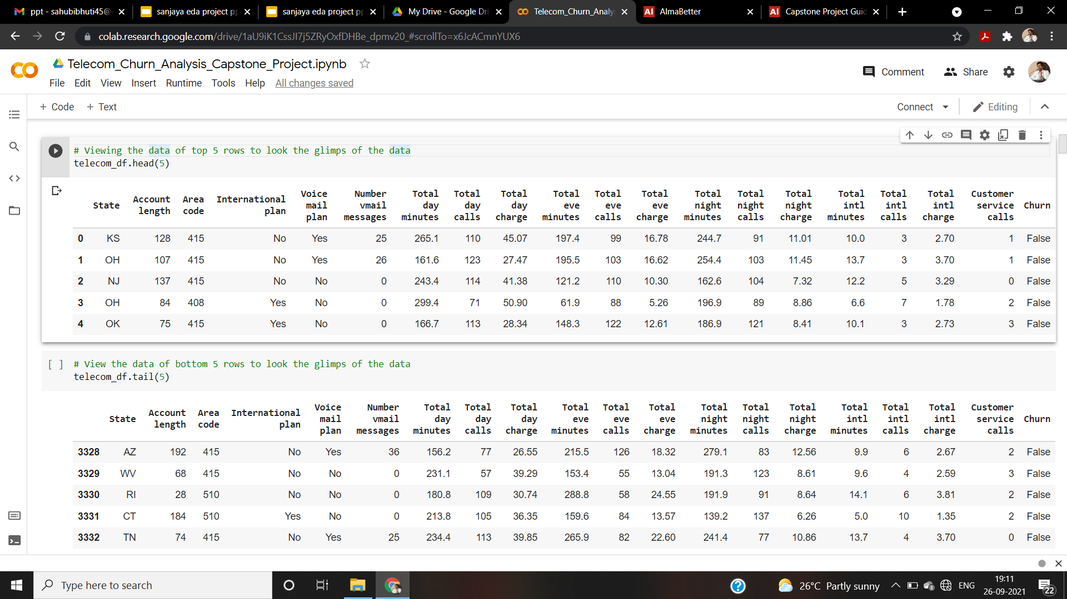
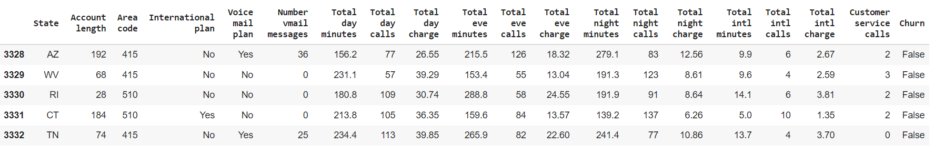
Data Summary:-

Slide 7
Feature Description:-
TOTAL (DAY/EVENING/NIGHT/INTERNATIONAL) (MINUTES/CALLS/CHARGES):
These are total 12 columns, and all are numerical data types. These contain the data of calls, minutes, charges of the customer with respective to the various time of the day and plan.
STATE:
There are 51 unique state present
ACCOUNT LENGTH:It is the length that the customer used their account
AREA CODE: There are 3 unique area code present

Slide 8
Feature Selection:-
INTERNATIONAL PLAN & VOICEMAIL PLAN:
Both column are described as a categorical feature,yes means plan taken no means plan not taken
NO. OF VOICEMAIL MESSAGES:The number of voicemail make by the voicemail plan taken customer
Customer service calls:It is the number of calls made by the customer to operator service centre
Churn:it is our target dependent variable having boolean data type of true and false

Slide 9
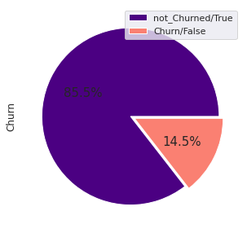
Analyzing Output/Variable (Churn):-
Below graph shows the percentage of how many customers are churned which tagged with False
Total Users number - 3333.
2850 - Non churn (85.5%)
483 - Churn (14.5%)

Slide 10
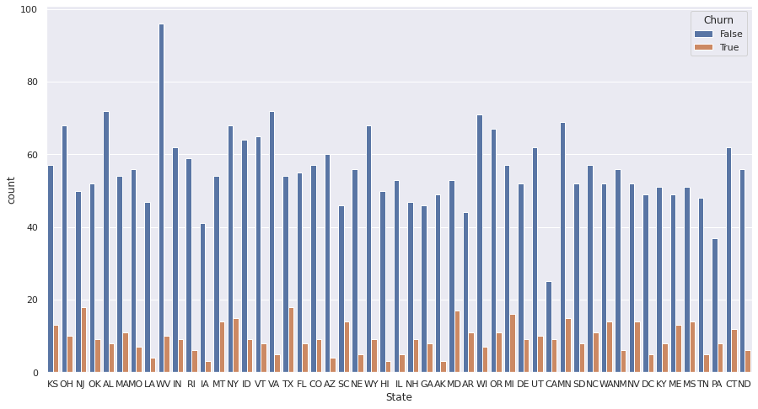
Analysis with state column
This block shows churn rate with state

Slide 11
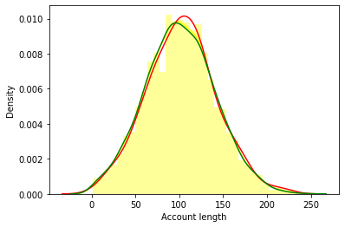
Analysis with Account Length vs Churn
Here is no sign of customers leaving because of the length of usage of their account

Slide 12
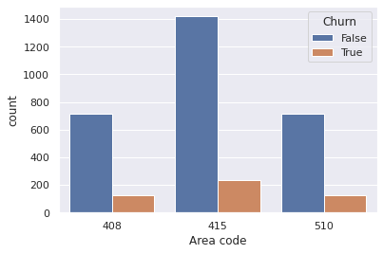
Area code Vs churn
Area code has only 3 unique values, and consider as a nominal data type and has equal number of churn

Slide 13
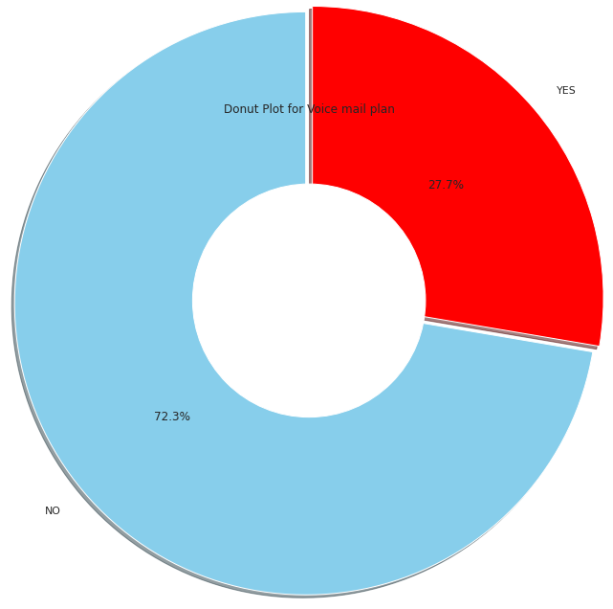
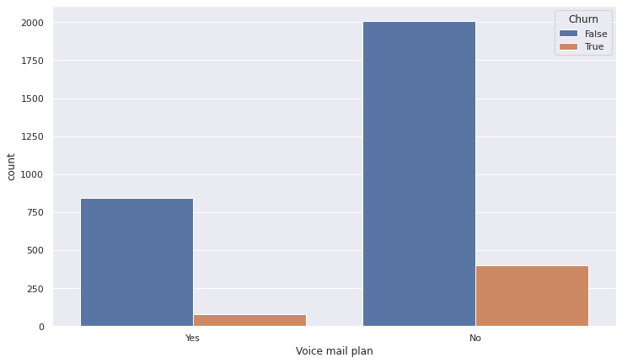
Voice mail and international plan with churn
This is plots which shows the churned and not churned customer respective to their plans
Voice mail plan International plan
922 people have voice plan
2411 don’t have voice plan

Slide 14
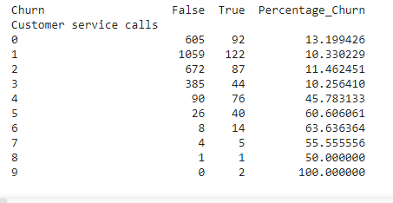
Customer services call with churn
It’s clear that after 4 calls at least 45% of the subscribers churn.
Customers with more than 4 service calls their probability of leaving is more

Slide 15
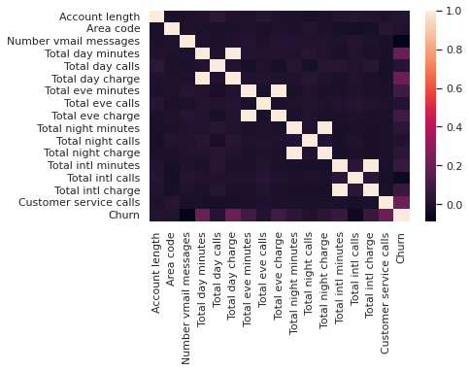
Correlation metrics graph

Slide 16
Challenges:-
Difficult to analyze all Total related columns at a one short time
Needs to plot all columns as required in data
Plotting of churn with respect to categorical data and need to analyze relation between them

Slide 17
Conclusion
Area code and account length do not play any kind of role regarding the churn rate.
In customer service calls data shows us that whenever an unsatisfied customer called the service centre the churn rate is high, which means the service centre didn't resolve the customer issue.

Slide 18
Recommondation
Provide discount to those customer who spent more minutes
Improve the service of call centre and take frequently feedback from the customer regarding their issue and try to solve it as soon as possible

